Slide 1
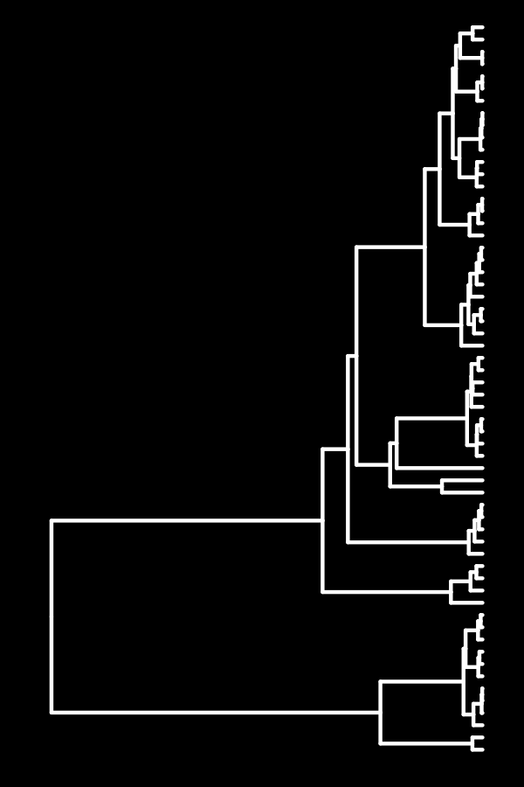
The promise of dynamic phylogenetic models for cultural evolution
Scott Claessens
University of Kent
26th November 2025, MPI-EVA
https://github.com/ScottClaessens/mpi-eva-talk

Slide 2
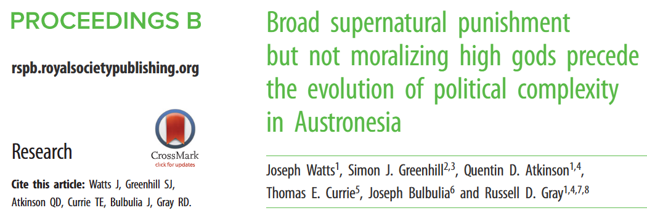
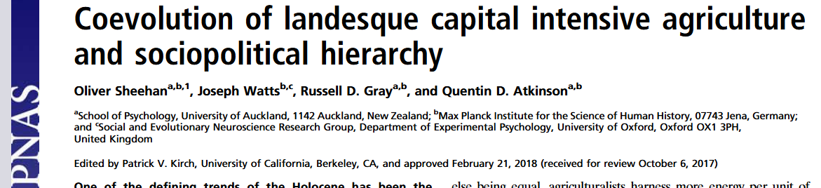
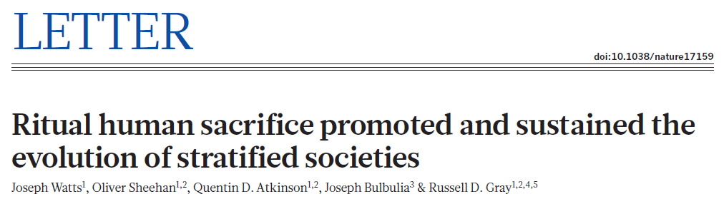
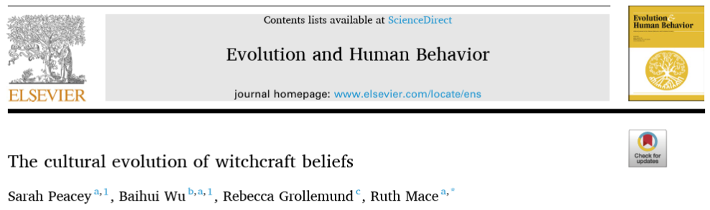
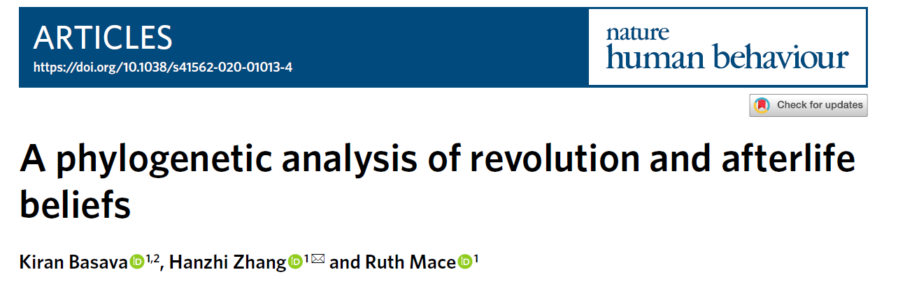
“Historical” causal inference

Slide 3
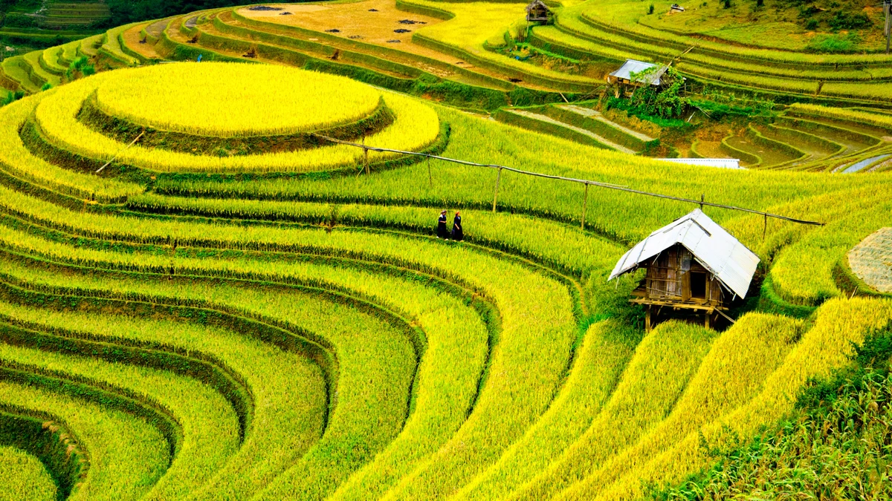
The “materialist” hypothesis:
Intensive agriculture drives the evolution of political complexity

Slide 4
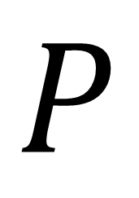
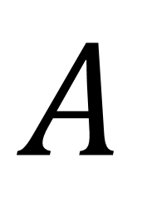
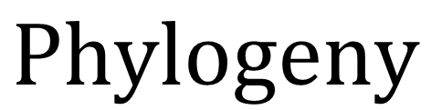
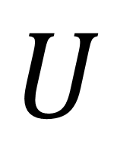
$$A$$
$$P$$
Agricultural intensity
Political
complexity
$$U$$
$$Phylogeny$$

Slide 5
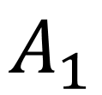
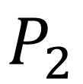
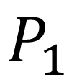
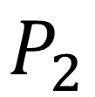
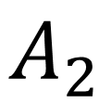
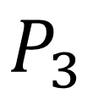
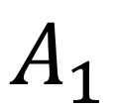
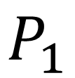
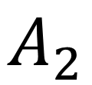
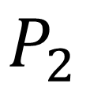
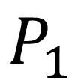
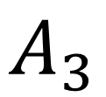
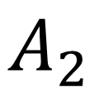
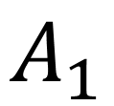
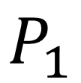
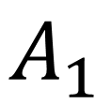
$$A_{1}$$
$$A_{3}$$
$$A_{2}$$
$$P_{1}$$
$$P_{3}$$
$$P_{2}$$
$$A_{1}$$
$$A_{2}$$
$$P_{1}$$
$$P_{2}$$
$$A_{1}$$
$$A_{2}$$
$$P_{1}$$
$$P_{2}$$
$$A_{1}$$
$$P_{1}$$

Slide 6
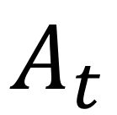
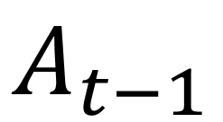
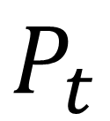
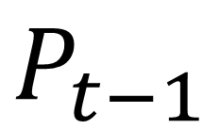
“autoregressive”
$$A_{t−1}$$
$$A_{t}$$
“cross-lagged”
$$P_{t−1}$$
$$P_{t}$$

Slide 7
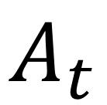
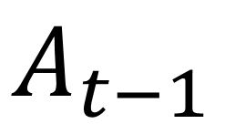
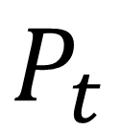
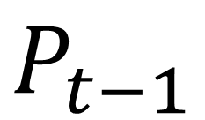
Phylogenetic comparative methods
Phylogenetic GLMMs
Discrete method in BayesTraits
Generalised dynamic phylogenetic models
$$A_{t−1}$$
$$A_{t}$$
$$P_{t−1}$$
$$P_{t}$$

Slide 8
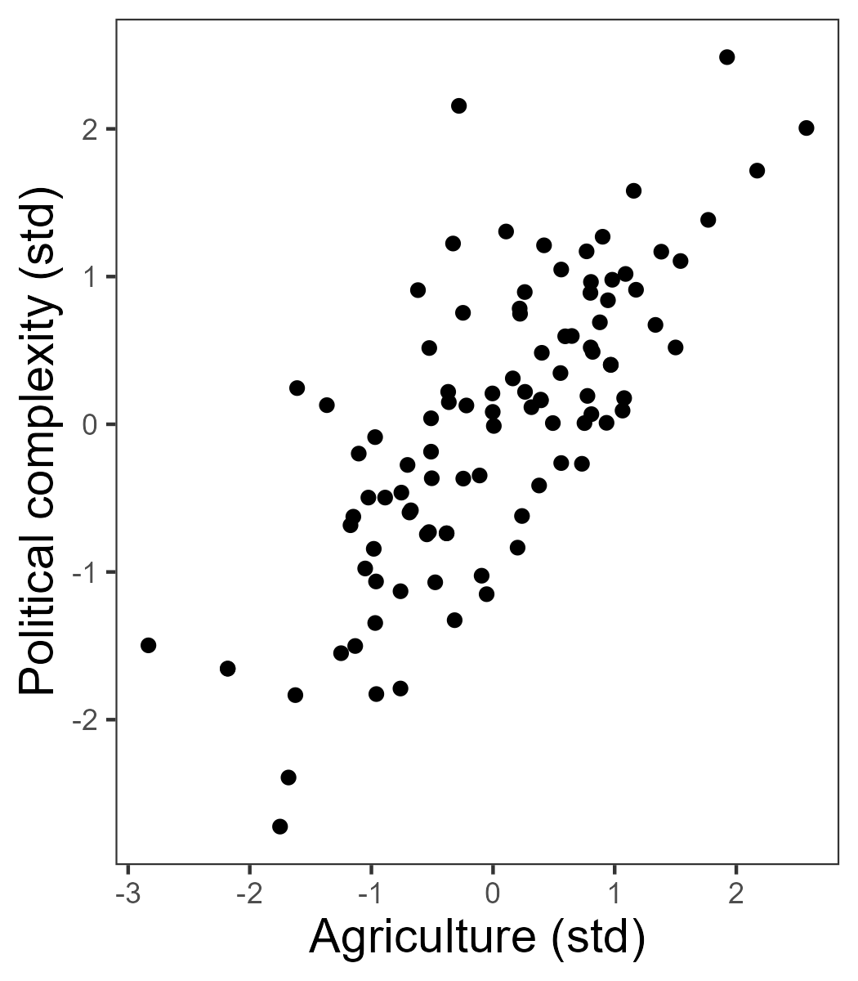
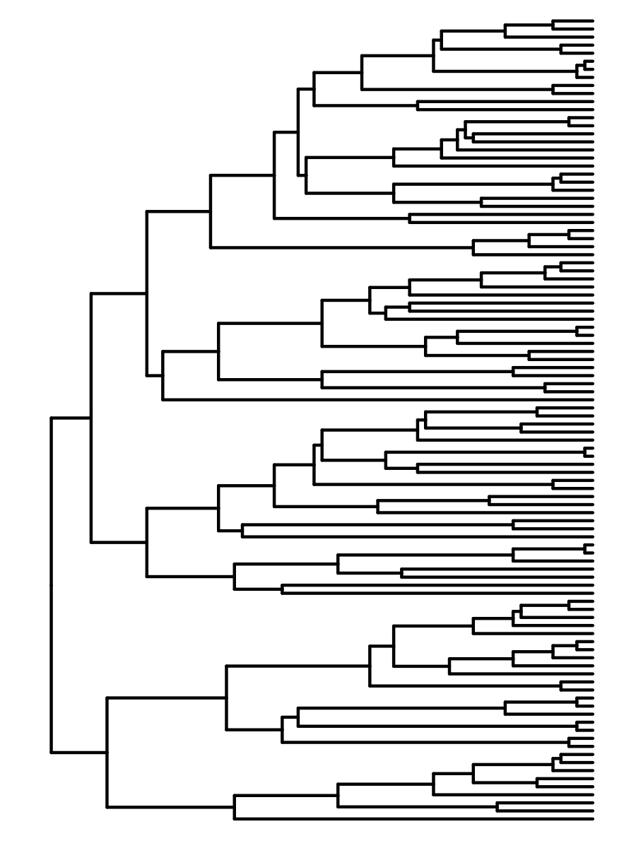
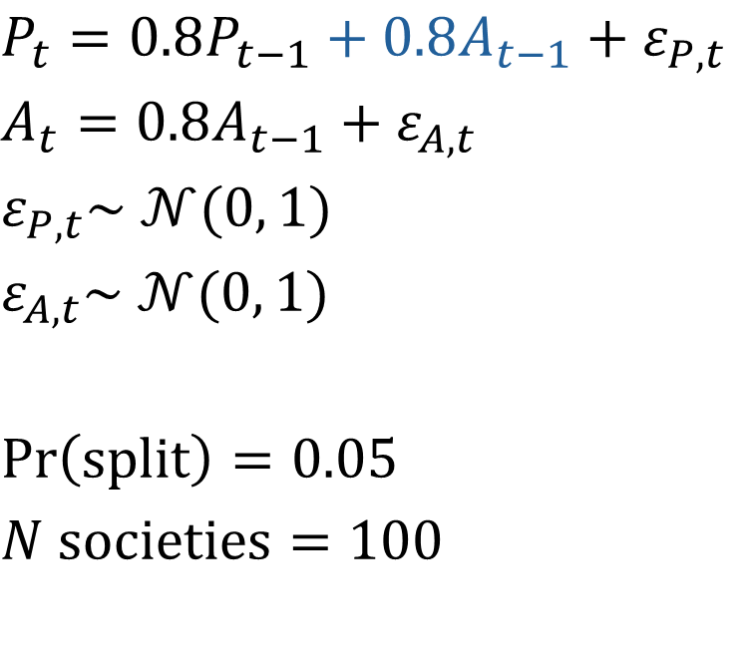
Synthetic data
$$P_{t}=0.8P_{t−1}+0.8A_{t−1}+ε_{P,t}$$
$$A_{t}=0.8A_{t−1}+ε_{A,t}$$
$$ε_{P,t}\sim 𝒩(0, 1)$$
$$ε_{A,t}\sim 𝒩(0, 1)$$
$$\operatorname{Pr}\left(split\right)=0.05$$
$$N societies=100$$

Slide 9
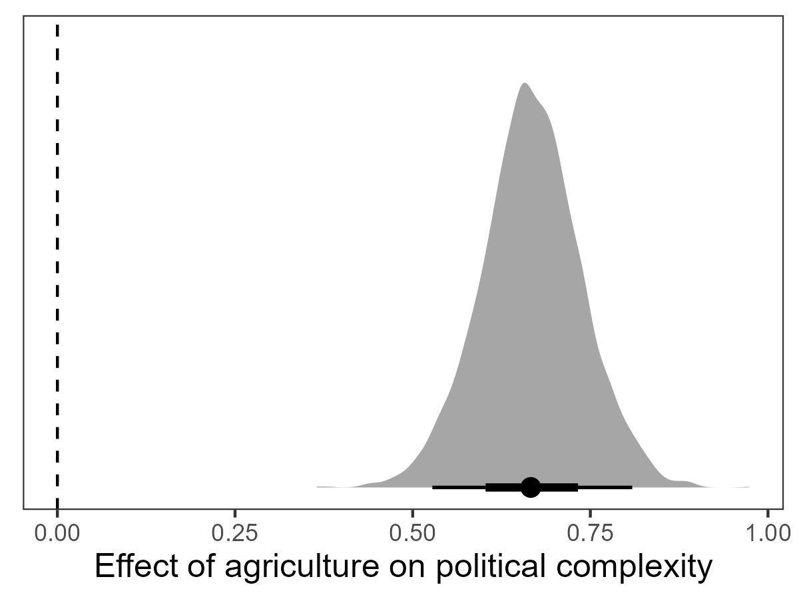
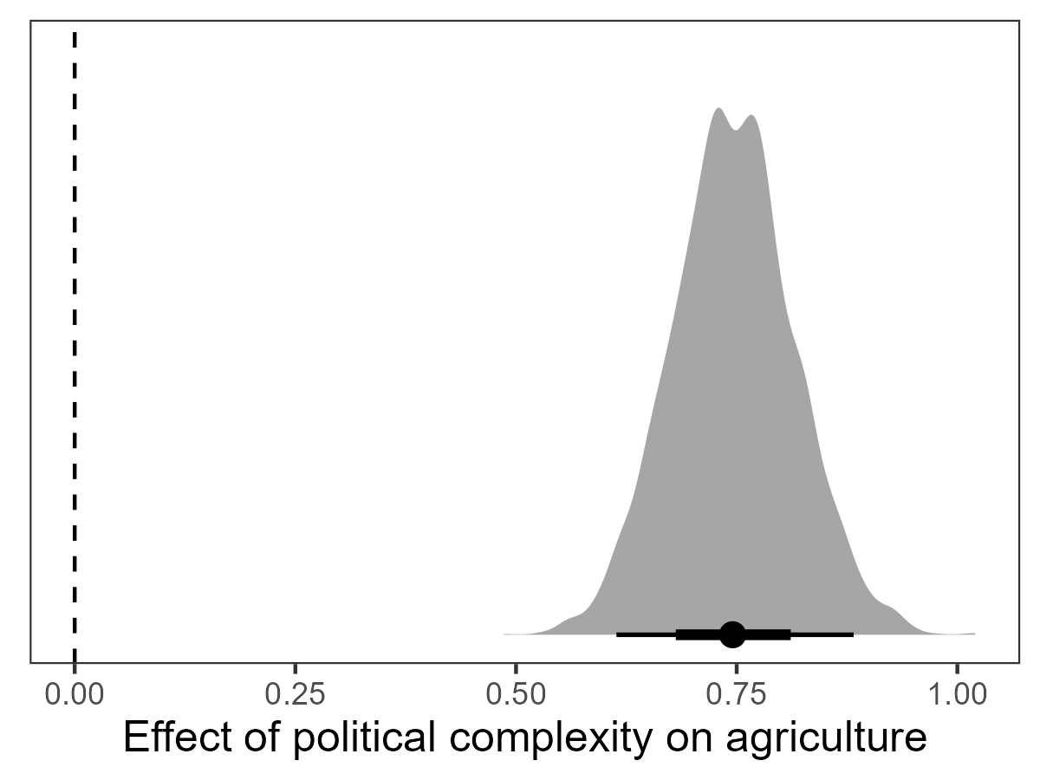
Phylogenetic GLMM
pol ~ agr + (1 | gr(id, cov = phylo))
agr ~ pol + (1 | gr(id, cov = phylo))

Slide 10
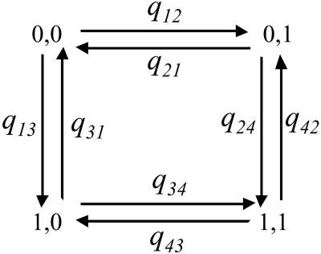
Discrete method in BayesTraits

Slide 11
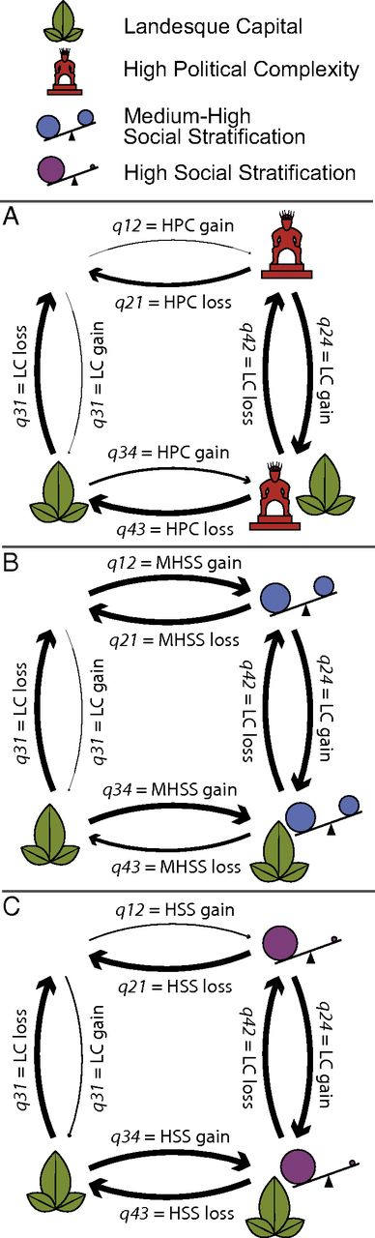
Discrete method in BayesTraits
Agriculture
Political complexity

Slide 12
Discrete method in BayesTraits
Log Bayes Factor = 39.08
Agriculture
Political complexity

Slide 13
Discrete method in BayesTraits
Gaining political complexity
Log Bayes Factor = 39.08
Agriculture
Political complexity

Slide 14
Discrete method in BayesTraits
Gaining agriculture
Log Bayes Factor = 39.08
Agriculture
Political complexity

Slide 15
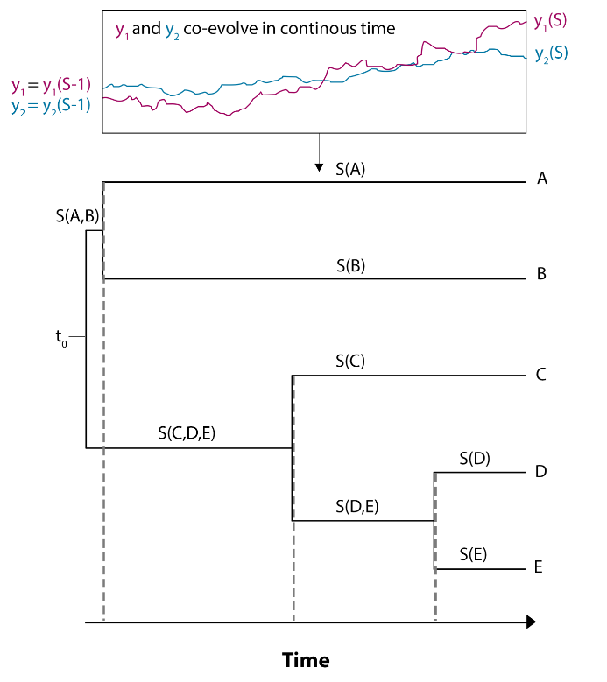


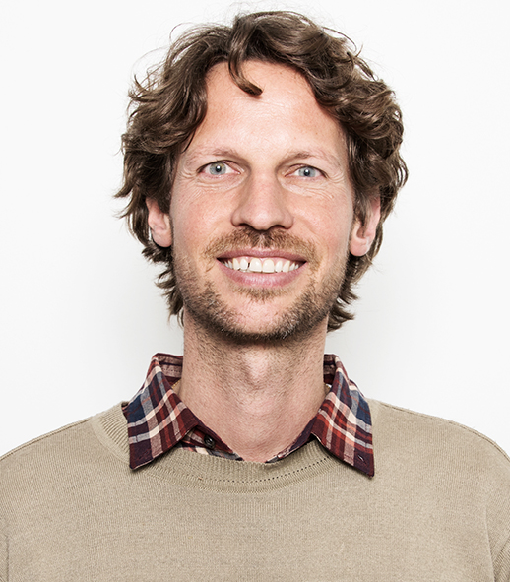
Generalised dynamic phylogenetic models
Erik Ringen
Jordan Martin
Adrian Jaeggi

Slide 16
$$dη\left(t\right)=\left(Aη\left(t\right)+b\right)+GdW(t)$$

Slide 17
change in latent traitηover time t
$$dη\left(t\right)=\left(Aη\left(t\right)+b\right)+GdW(t)$$

Slide 18
change in latent traitηover time t
$$dη\left(t\right)=\left(Aη\left(t\right)+b\right)+GdW(t)$$
“selection” component

Slide 19
change in latent traitηover time t
“drift” component
$$dη\left(t\right)=\left(Aη\left(t\right)+b\right)+GdW(t)$$
“selection” component

Slide 20
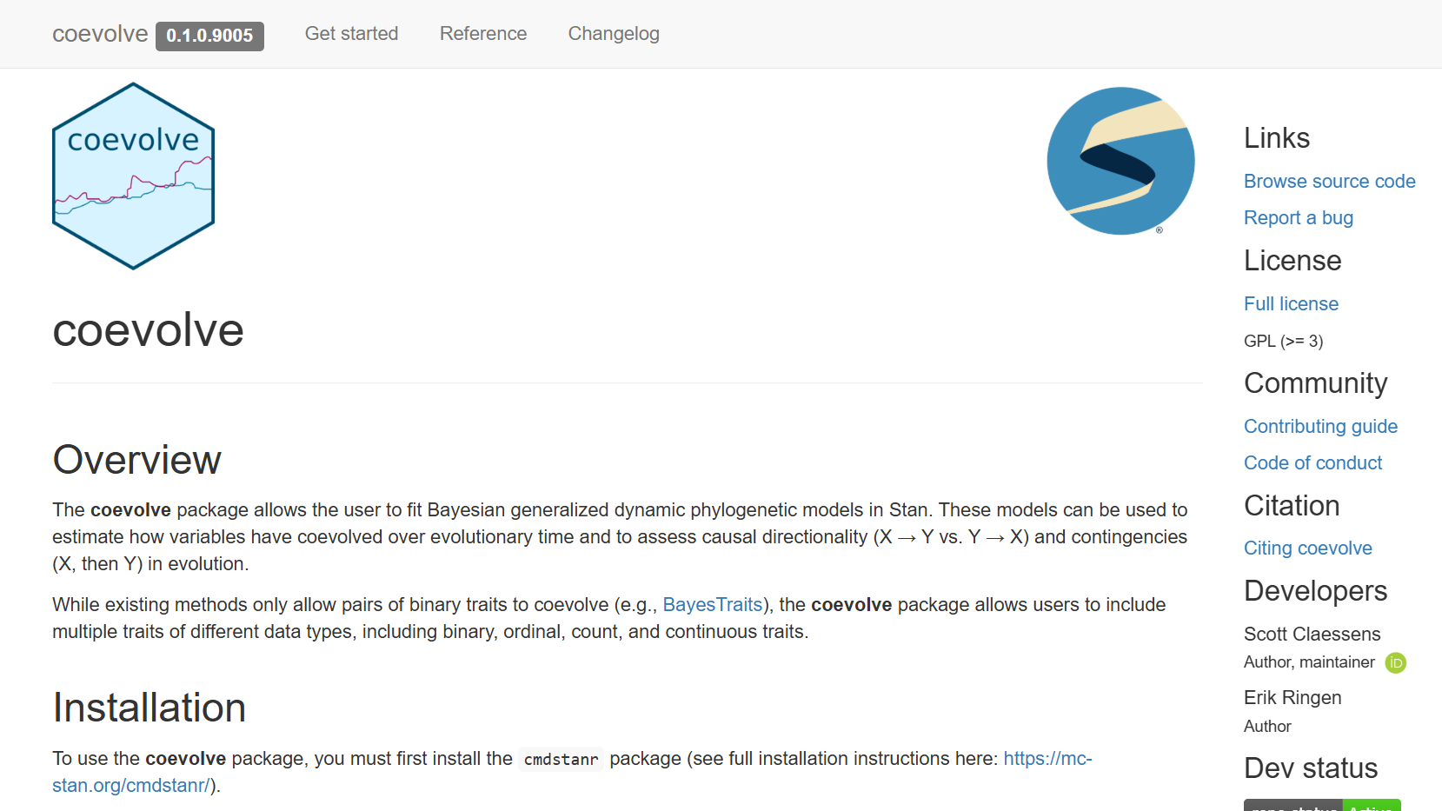

Slide 21
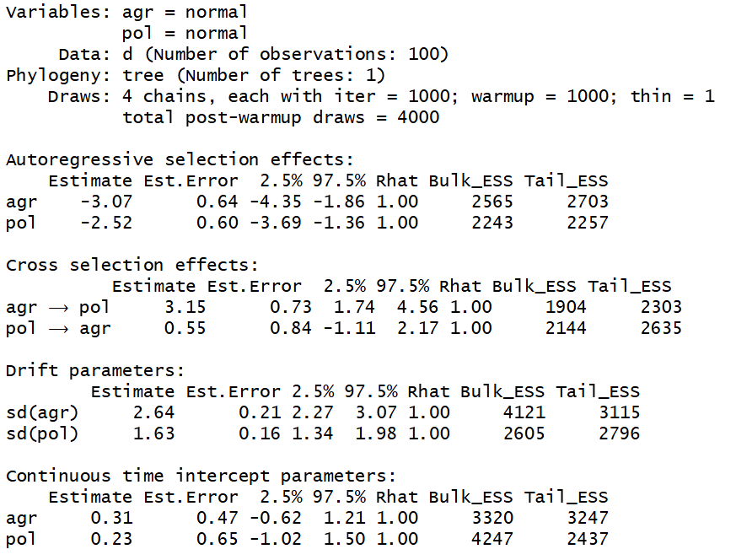
library(coevolve)
coev_fit(
data = d,
variables = list(
agr = “normal”,
pol = “normal”
),
id = “id”,
tree = tree
)

Slide 22
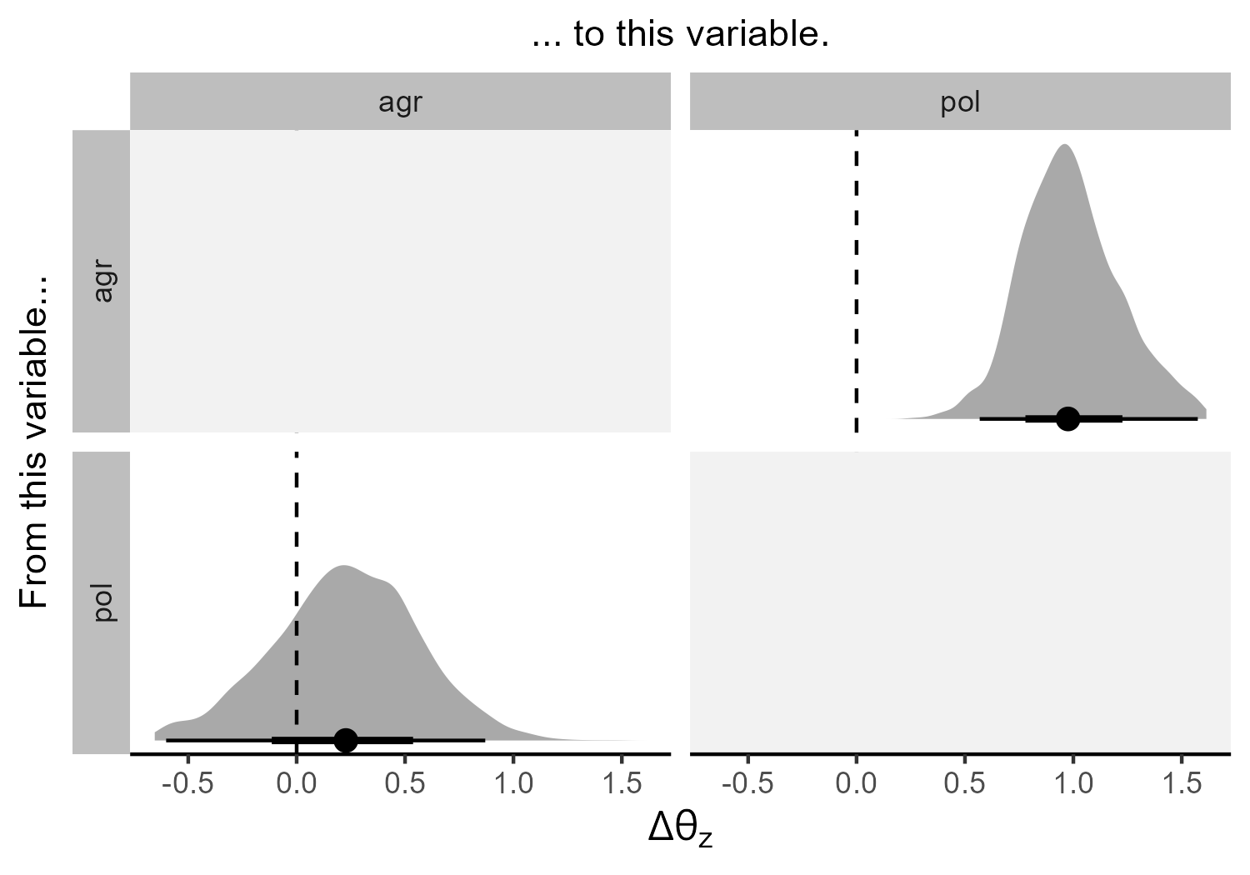

Slide 23
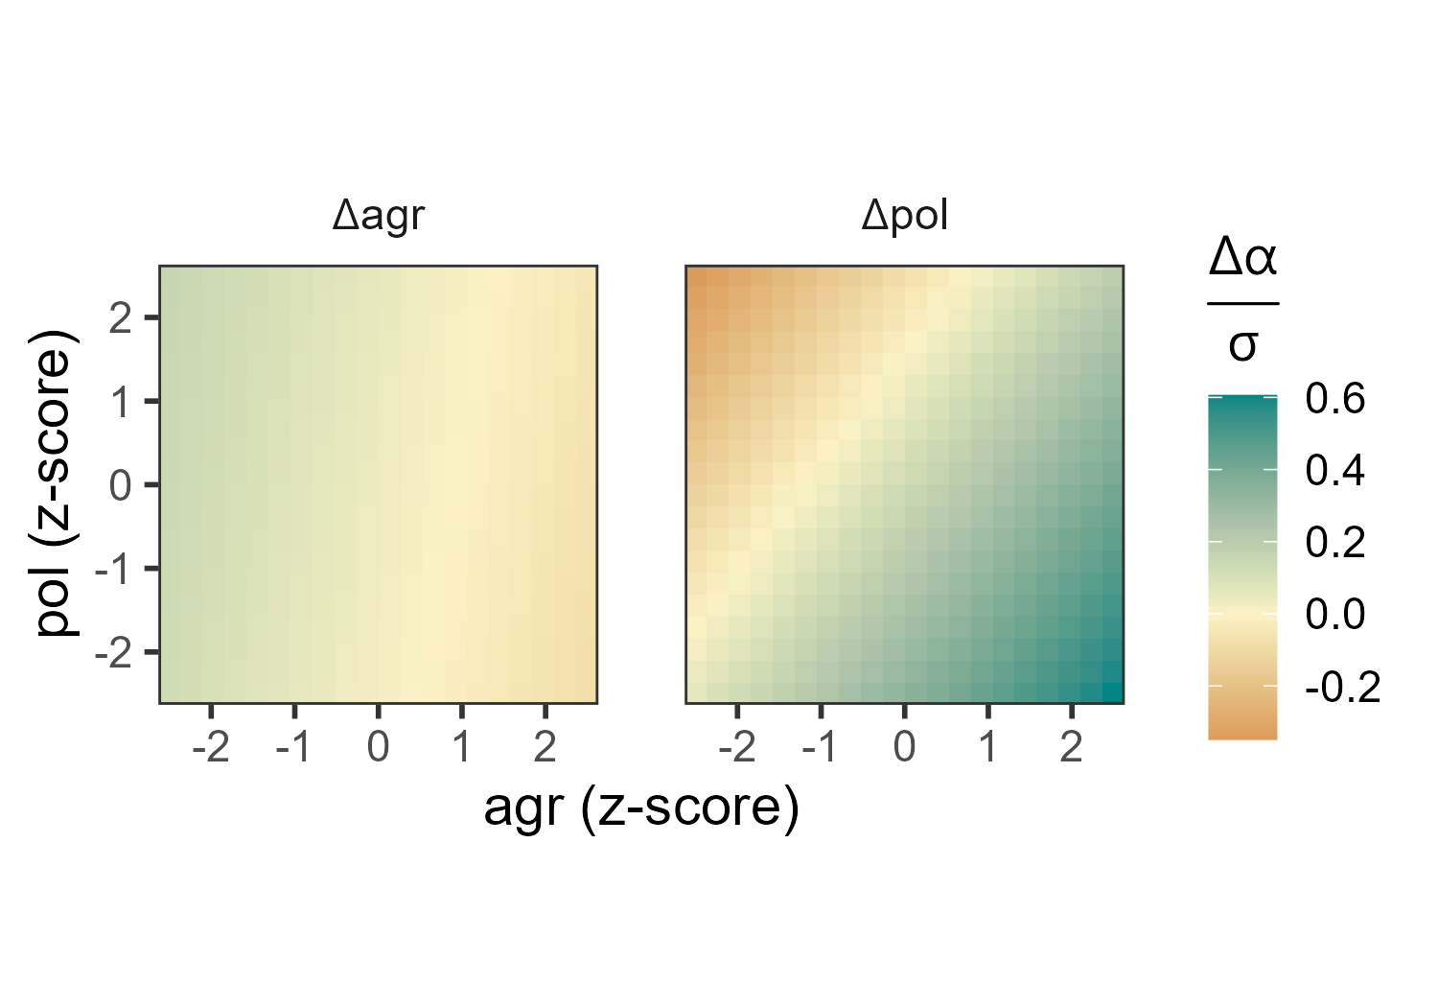
negative selection
positive selection

Slide 24
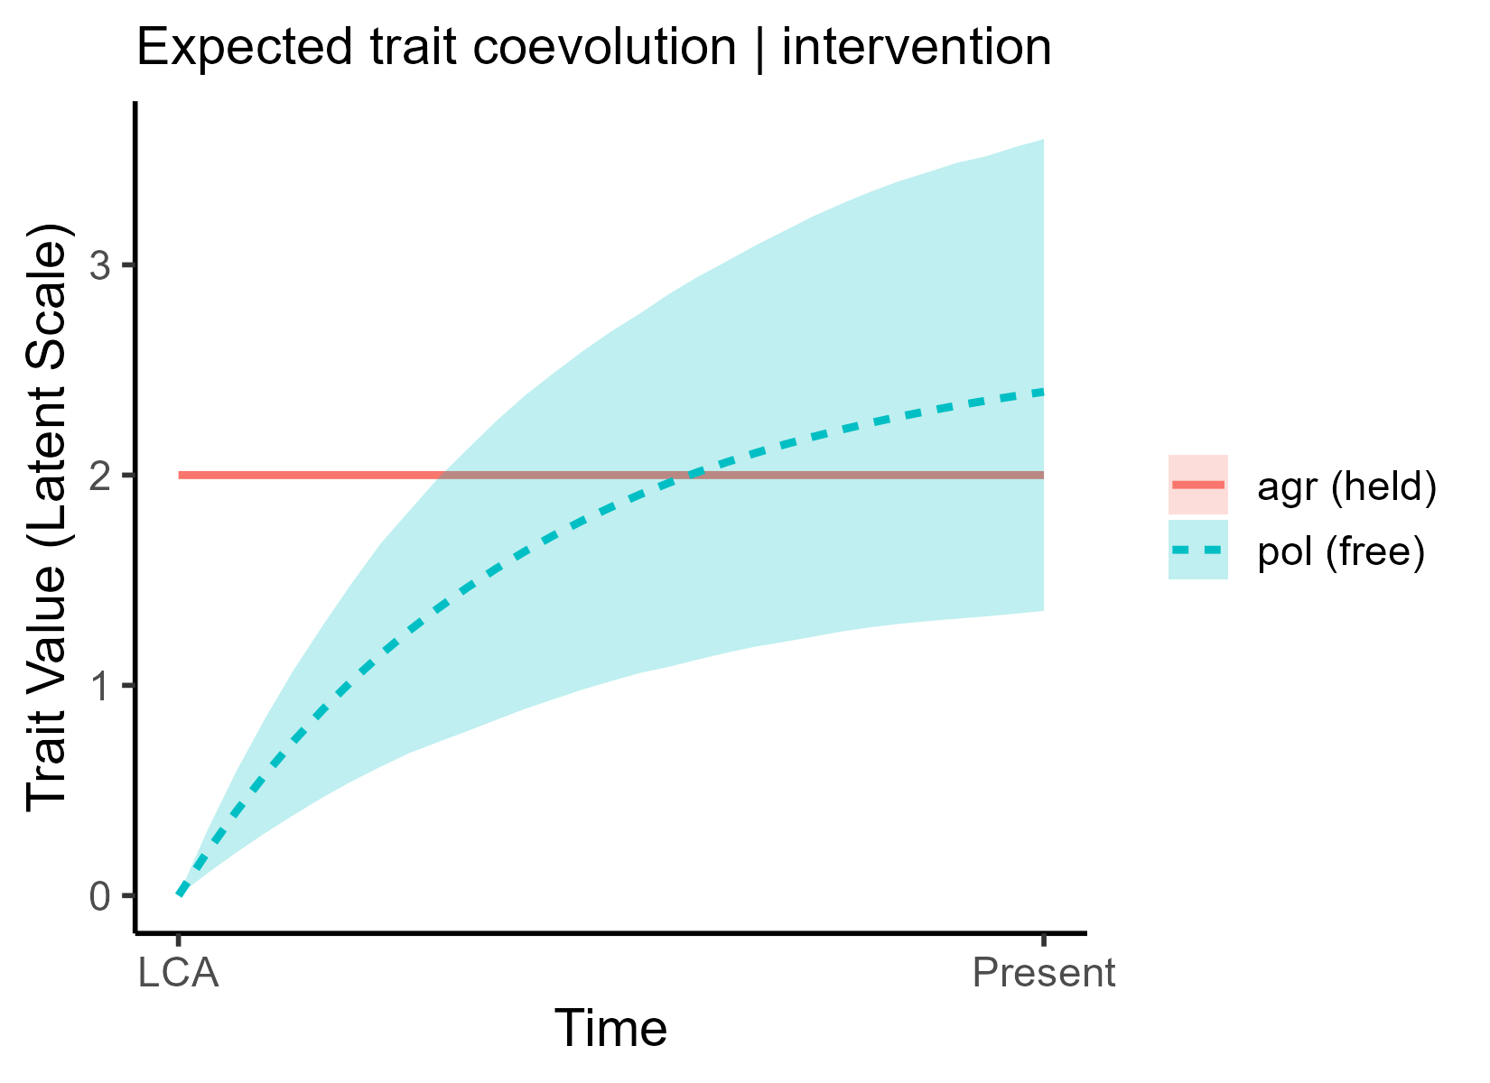

Slide 25

More possibilities!
Different data types – binary, count, ordinal, continuous, positive real
More than two variables
Repeated observations
Missing data and measurement error
Iterate over posterior samples of trees
Control for spatial autocorrelation

Slide 26
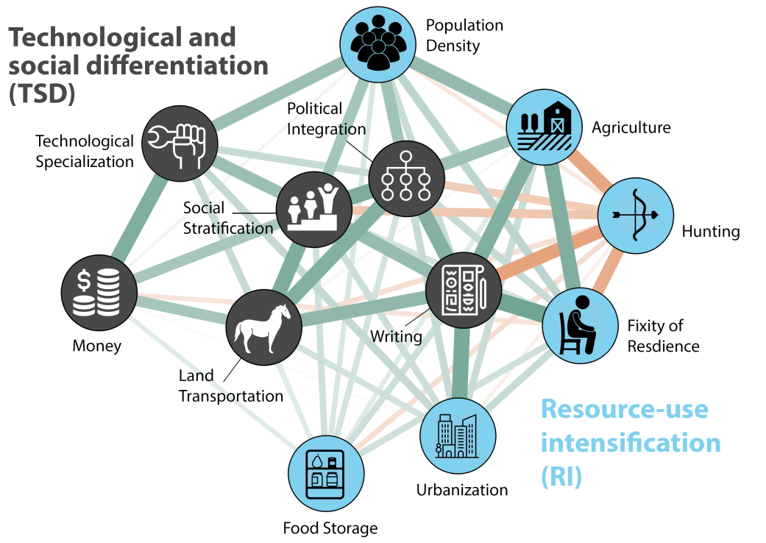

Applications in cultural evolution
Ringen et al. (pre-print)

Slide 27


Applications in cultural evolution
Sheehan et al. (2023)

Slide 28


Applications in cultural evolution
Hrnčíř et al. (under review)

Slide 29
Limitations
Assumes constant equilibrium values through time – unrealistic?
May be underpowered with small trees
Potentially long computation times
Currently no support for latent variables
Currently doesn’t incorporate fossil information

Slide 30



Slide 31


Slide 32




In summary
The field of cultural evolution seeks to estimate “historical” causal effects
Existing phylogenetic comparative methods have limitations on the number and type of traits
Generalised dynamic phylogenetic models offer a powerful new tool for addressing historical causal questions
$$A_{t−1}$$
$$A_{t}$$
$$P_{t−1}$$
$$P_{t}$$

Slide 33



Thank you! Questions?
Erik Ringen
Jordan Martin
Adrian Jaeggi
Russell Gray
Václav Hrnčíř
Oliver Sheehan

